Slide 1
Java review – Chapters 1 through 9 cont.

Slide 2
Classes
A Java class uses variables to define data fields and methods to define behaviors.
Additionally, a class provides a special type of methods, known as constructors, which are invoked to create new objects from the class.

Slide 3
Classes
The Circle class does not have a main method and it cannot run.
It is only a definition for circle objects.

Slide 4
UML Class Diagram (Unified Modeling Language)
dataFieldName: dataFieldType
ClassName(parameterName:parameterType)
methodName(parameterName:parameteType): returnType

Slide 5
Declaring/Creating Objects in a Single Step
ClassName objectRefVar = new ClassName();
Example:
Circle myCircle = new Circle();
Assign object reference
Create an object

Slide 6
Accessing Object’s Members
An object’s data and methods can be accessed through the dot (.) operator via the object’s reference variable
Referencing the object’s data:
objectRefVar.data
e.g., myCircle.radius
Invoking the object’s method:
objectRefVar.methodName(arguments)
e.g., myCircle.getArea()

Slide 7
Example: Defining Classes and Creating Objects
Objective: Demonstrate creating objects, accessing data, and using methods.
To create 2 classes in the program.
1st class is the main class (public class), and it is used to test the 2nd class
This program is a client of the class

Slide 8
public class TestCircle {
/** Main method */
public static void main(String[] args) {
// Create a circle with radius 1
Circle circle1 = new Circle();
System.out.println("The area of the circle1 of radius "
+ circle1.radius + " is " + circle1.getArea());
// Create a circle with radius 25
Circle circle2 = new Circle(25);
System.out.println("The area of the circle2 of radius "
+ circle2.radius + " is " + circle2.getArea());
// Create a circle with radius 125
Circle circle3 = new Circle(125);
System.out.println("The area of the circle3 of radius "
+ circle3.radius + " is " + circle3.getArea());
The new operator is used to create an object from the constructor
These 3 objects (circle1, circle2 and circle3) have different data but the same methods
The data field can be accessed via the reference of the object using circle1.radius
The object can invoke its method via the reference of the object using circle1.getArea()

Slide 9
// Modify circle2 radius
circle2.radius = 100; // or circle2.setRadius(100)
System.out.println("The area of the circle2 of radius "
+ circle2.radius + " is " + circle2.getArea());
}
}
// Define the circle class with two constructors
public class Circle {
double radius; //data field
/** Construct a circle with radius 1 */
public Circle() {
radius = 1;
}
/** Construct a circle with a specified radius */
public Circle(double newRadius) {
radius = newRadius;
}

Slide 10
/** Return the area of this circle */
public double getArea() {
return radius * radius * Math.PI;
}
/** Return the perimeter of this circle */
public double getPerimeter() {
return 2 * radius * Math.PI;
}
/** Set a new radius for this circle */
public void setRadius(double newRadius) {
radius = newRadius;
}
}

Slide 11
Constructors
· Constructors must have the same name as the class itself.
· Constructors do not have a return type—not even void.
· Constructors are invoked using the new operator when an object is created. Constructors play the role of initializing objects.

Slide 12
Creating Objects Using Constructors
A constructor with no parameters is referred to as a no-arg constructor.
Example:
new Circle(); //create an object of the Circle class
A class may be defined without constructors.
In this case, a no-arg constructor with an empty body is implicitly defined in the class.
This constructor, called a default constructor, is provided automatically only if no constructors are explicitly defined in the class.

Slide 13
Reference Data Fields
The data fields can be of reference types.
For example, the following Student class contains a data field name of the String type.
public class Student {
String name; // name has default value null
int age; // age has default value 0
boolean isScienceMajor; // isScienceMajor has default //value false
char gender; // c has default value '\u0000'
}
If a data field of a reference type does not reference any object, the data field holds a special literal value, null.
Null is a literal for a reference type

Slide 14
Differences between Variables of Primitive Data Types and Object Types

Slide 15
Copying Variables of Primitive Data Types and Object Types

Slide 16
Garbage Collection
after the assignment statement c1 = c2,
c1 points to the same object referenced by c2.
The object previously referenced by c1 is no longer referenced.
This object is known as garbage.
Garbage is automatically collected by JVM.

Slide 17
Static Variables, Constants, and Methods
Static variables are shared by all the objects (instances) of the class.
Static methods are not tied to a specific object.
Static constants are final variables shared by all the objects (instances) of the class.
To declare static variables, constants, and methods, use the static modifier.
Instance variable
It’s tied to a specific instance of the class

Slide 18
Example of Using Instance and static Variables and Method
Objective: Demonstrate the roles of instance and static variables and their uses.
This example adds a static variable numberOfObjects to track the number of Circle objects created.

Slide 19
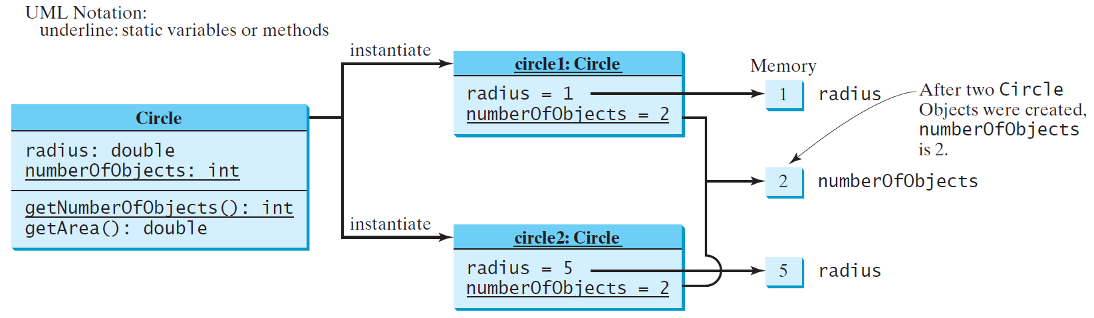
Static Variables, Constants, and Methods, cont.

Slide 20
public class Circle { //with static members
/** The radius of the circle */
double radius; //data field
/** The number of the objects created */
static int numberOfObjects = 0;
/** Construct a circle with radius 1 */
public Circle () {
radius = 1.0;
numberOfObjects++;
}
/** Construct a circle with a specified radius */
public Circle (double newRadius) {
radius = newRadius;
numberOfObjects++;
}
/** Return numberOfObjects */
static int getNumberOfObjects() {
return numberOfObjects;
}
}

Slide 21
/** Return the area of this circle */
public double getArea() {
return radius * radius * Math.PI;
}
/** Return the perimeter of this circle */
public double getPerimeter() {
return 2 * radius * Math.PI;
}
/** Set a new radius for this circle */
public void setRadius(double newRadius) {
radius = newRadius;
}
}//end class

Slide 22
public class TestCircleWithStaticMembers {
/** Main method */
public static void main(String[] args) {
System.out.println("Before creating objects");
System.out.println("The number of Circle objects is " + Circle.numberOfObjects);
// Create c1
Circle c1 = new Circle();
// Display c1 BEFORE c2 is created
System.out.println("\nAfter creating c1");
System.out.println("c1: radius (" + c1.radius + ") and number of Circle objects (" +
c1.numberOfObjects + ")");
// Create c2
Circle c2 = new Circle(5);
// Modify c1
c1.radius = 9;
// Display c1 and c2 AFTER c2 was created
System.out.println("\nAfter creating c2 and modifying c1");
System.out.println("c1: radius (" + c1.radius +") and number of Circle objects (" +
c1.numberOfObjects + ")");
System.out.println("c2: radius (" + c2.radius + ") and number of Circle objects (" +
c2.numberOfObjects + ")");
}
}

Slide 23
Visibility Modifiers
public
The class, data, or method is visible to any class in any package.
private
The data or methods can be accessed only by the declaring class.
With no visibility modifier, by default, the class, variable, or method can be accessed by any class in the same package.

Slide 24
Why Data Fields Should Be private? (data field encapsulation)
To protect data.
To make code easy to maintain.

Slide 25
Accessor/Mutator Methods
The get and set methods are used to read and modify private data field.
The getter method is referred to as accessor
public returnType getPropertyName()
public boolean isPropertyName()
The setter method is referred to as mutator
public void setPropertyName(dataType propertyValue)

Slide 26
Example of Data Field Encapsulation

Slide 27
public class Circle { //WithPrivateDataFields
/** The radius of the circle */
private double radius = 1;
/** The number of the objects created */
private static int numberOfObjects = 0;
/** Construct a circle with radius 1 */
public Circle() {
numberOfObjects++;
}
/** Construct a circle with a specified radius */
public Circle(double newRadius) {
radius = newRadius;
numberOfObjects++;
}
/** Return radius */
public double getRadius() {
return radius;
}

Slide 28
/** Set a new radius */
public void setRadius(double newRadius) {
radius = (newRadius >= 0) ? newRadius : 0;
}
/** Return numberOfObjects */
public static int getNumberOfObjects() {
return numberOfObjects;
}
/** Return the area of this circle */
public double getArea() {
return radius * radius * Math.PI;
}
}

Slide 29
public class TestCircleWithPrivateDataFields {
/** Main method */
public static void main(String[] args) {
// Create a Circle with radius 5.0
Circle myCircle = new Circle (5.0);
System.out.println("The area of the circle of radius "
+ myCircle.getRadius() + " is " + myCircle.getArea());
// Increase myCircle's radius by 10%
myCircle.setRadius(myCircle.getRadius() * 1.1);
System.out.println("The area of the circle of radius "
+ myCircle.getRadius() + " is " + myCircle.getArea());
}
}

Slide 30
Passing Objects to Methods
Passing by value for primitive type value (the copy of value is passed to the parameter)
Passing by value for reference type value (the value is the reference to the object)

Slide 31
public class TestPassObject {
public static void main(String[] args) {
Circle myCircle = new Circle (1); // Create a Circle object with radius 1
int n = 5; // Print areas for radius 1, 2, 3, 4, and 5.
printAreas(myCircle, n);
// See myCircle.radius and times
System.out.println("\n" + "Radius is " + myCircle.getRadius());
System.out.println("n is " + n);
}
/** Print a table of areas for radius */
public static void printAreas(Circle c, int times) {
System.out.println("Radius \t\tArea");
while (times >= 1) {
System.out.println(c.getRadius() + "\t\t" + c.getArea());
c.setRadius(c.getRadius() + 1);
times--;
}
}
}
Radius Area
1.0 3.141592653589793
2.0 12.566370614359172
3.0 28.274333882308138
4.0 50.26548245743669
5.0 78.53981633974483
Radius is 6.0
n is 5

Slide 32
The this Keyword
The this keyword refers to an object itself.
One common use of the this keyword is reference a class’s hidden data fields.
Another common use of the this keyword to enable a constructor to invoke another constructor of the same class.

Slide 33
Reference the Hidden Data Fields

Slide 34
Calling Overloaded Constructor

Slide 35
Class Abstraction and Encapsulation
Class abstraction means to separate class implementation from the use of the class.
The creator of the class provides a description of the class and let the user know how the class can be used.
The user of the class does not need to know how the class is implemented. The detail of implementation is encapsulated and hidden from the user.

Slide 36
Inheritance
Inheritance allow you to define a general class(suppereclass) and later extend it to more specialized classes(subclasses)
Inheritance: to define new classes from existing classes.
The specialized classes(subclasses) inherit the properties and methods from the general class(suppereclass)
A subclass inherits accessible data fields and methods from its superclass and may also add new data fields and methods

Slide 37
Superclasses/parent class/base class
A triangular arrow pointing to the generalized class is to indicate the inheritance relationship
Subclasse/
Child class/
Extended class
Subclasses/
Child class/
Extended class

Slide 38
Is-a relationship
The subclass and its superclass form a is-a relationship.
Eg. A Circle object is a special type of general GeometricObject
The Circle class extends the GeometricObject class, syntax is:
public class Circle extends GeometricObject
Circle class inherits the methods getColor, setColor, isFilled, setFilled and toString from GeometricObject class
Sublclass
Supperclass

Slide 39
public class GeometricObject {
private String color = "white";
private boolean filled; //default with false value
private java.util.Date dateCreated;
/** Construct a default geometric object */
public GeometricObject() {
dateCreated = new java.util.Date(); //the date when the object is created
}
/** Construct a geometric object with the specified color and filled value */
public GeometricObject(String color, boolean filled) {
dateCreated = new java.util.Date(); //the date when the object is created
this.color = color;
this.filled = filled;
}
/** Return color */
public String getColor() {
return color;
}
/** Set a new color */
public void setColor(String color) {
this.color = color;
}

Slide 40
/** Return filled. Since filled is boolean, its get method is named isFilled */
public boolean isFilled() {
return filled;
}
/** Set a new filled */
public void setFilled(boolean filled) {
this.filled = filled;
}
/** Get dateCreated */
public java.util.Date getDateCreated() {
return dateCreated;
}
/** Return a string representation of this object */
public String toString() {
return "created on " + dateCreated + "\ncolor: " + color +
" and filled: " + filled;
}
}

Slide 41
public class Circle extends GeometricObject {
private double radius; //new data field
//default constructor
public Circle () {
}
//another constructor
public Circle (double radius) {
this.radius = radius;
}
//another constructor
public Circle(double radius, String color, boolean filled) {
this.radius = radius;
setColor(color);
setFilled(filled);
}
/** Return radius */
public double getRadius() {
return radius;
}
/** Set a new radius */
public void setRadius(double radius) {
this.radius = radius;
}
Need to use public setter (mutators) to mutate private data fields in superclass
this.color = color //illegal
this.filled = filled //illegal

Slide 42
/** Return area */
public double getArea() {
return radius * radius * Math.PI;
}
/** Return diameter */
public double getDiameter() {
return 2 * radius;
}
/** Return perimeter */
public double getPerimeter() {
return 2 * radius * Math.PI;
}
/* Print the circle info */
public void printCircle() {
System.out.println("The circle is created " + getDateCreated() +
" and the radius is " + radius);
}
}

Slide 43
public class Rectangle extends GeometricObject {
private double width; //new data field
private double height; //new data field
//default constructor
public Rectangle () {
}
//another constructor
public Rectangle (double width, double height) {
this.width = width;
this.height = height;
}
//another constructor
public Rectangle (double width, double height, String color, boolean filled) {
this.width = width;
this.height = height;
setColor(color);
setFilled(filled);
}
/** Return width */
public double getWidth() {
return width;
}
Need to use public setter (mutators) to mutate private data fields in superclass
this.color = color //illegal
this.filled = filled //illegal

Slide 44
/** Set a new width */
public void setWidth(double width) {
this.width = width;
}
/** Return height */
public double getHeight() {
return height;
}
/** Set a new height */
public void setHeight(double height) {
this.height = height;
}
/** Return area */
public double getArea() {
return width * height;
}
/** Return perimeter */
public double getPerimeter() {
return 2 * (width + height);
}
}

Slide 45
public class TestCircleRectangle {
public static void main(String[] args) {
Circle circle = new Circle(1);
System.out.println("A circle " + circle.toString());
System.out.println("The color is " + circle.getColor());
System.out.println("The radius is " + circle.getRadius());
System.out.println("The area is " + circle.getArea());
System.out.println("The diameter is " + circle.getDiameter());
Rectangle rectangle =new Rectangle(2, 4);
System.out.println("\nA rectangle " + rectangle.toString());
System.out.println("The area is " + rectangle.getArea());
System.out.println("The perimeter is " +
rectangle.getPerimeter());
}
}
A circle created on Mon Sep 30 14:18:03 PDT 2019
color: white and filled: false
The color is white
The radius is 1.0
The area is 3.141592653589793
The diameter is 2.0
A rectangle created on Mon Sep 30 14:18:03 PDT 2019
color: white and filled: false
The area is 8.0
The perimeter is 12.0

Slide 46
Note
A subclass is NOT a subset of a superclass.
A subclass usually contains more information and methods than its superclass
Private data fields in a superclass are not accessible outside the class
The extends keyword is used to define a subclass that extends a superclass.
Single inheritance allows a subclass to extend only one superclass.
Multiple inheritance allows a subclass to extend multiple classes.
Java does not allow multiple inheritance.

Slide 47
Are superclass’s Constructor Inherited?
No.
A superclass's constructors are not inherited in the subclass.
superclass’s Constructor are invoked explicitly or implicitly.
Explicitly using the super keyword.
superclass's constructors can only be invoked from the subclasses' constructors, using the keyword super.
If the keyword super is not explicitly used, the superclass's no-arg constructor is automatically invoked.

Slide 48
Using the Keyword super
The keyword super refers to the superclass of the class in which super appears.
This keyword can be used in two ways:
To call a superclass constructor
To call a superclass method

Slide 49
Calling Superclass Constructor
The syntax to call a superclass’s constructor:
super() //invokes the no-arg constructor of its superclass
or super(arguments) //invokes the superclass constructor that matches the arguments
The statement super() or super(argument) must be the 1st statement of the subclass’s constructor

Slide 50
Calling Superclass Constructor
public Circle(double radius, String color, boolean filled) {
this.radius = radius;
setColor(color);
setFilled(filled);
}
public Circle(double radius, String color, boolean filled) {
super(color, filled);
this.radius = radius;
}
invokes the superclass constructor that matches the arguments
must be the 1st statement of the subclass’s constructor

Slide 51
Calling Superclass Methods
/* Print the circle info */
public void printCircle() {
System.out.println("The circle is created " + getDateCreated() + " and the radius is " + radius);
}
You could rewrite the printCircle() method in the Circle class as follows:
public void printCircle() {
System.out.println("The circle is created " +
super.getDateCreated() + " and the radius is " + radius);
}

Slide 52
Defining a Subclass
A subclass inherits from a superclass.
You can also:
Add new properties
Add new methods
Override the methods of the superclass

Slide 53
Overriding Methods in the Superclass
A subclass inherits methods from a superclass.
Sometimes it is necessary for the subclass to modify the implementation of a method defined in the superclass. This is referred to as method overriding.
To override a method, the method must be defined in the subclass using the same signature as in its superclass
To write a new version of a method in a subclass that replaces the superclass's version.

Slide 54
Overriding Methods in the Superclass
The toString method in the GeometricObject class return a string representation of a geometric object
public String toString() {
return "created on " + dateCreated + "\ncolor: " + color +
" and filled: " + filled;
}
public class Circle extends GeometricObject {
// Other methods are omitted
//Override the toString method defined in GeometricObject to return the string //representation of a circle
public String toString() {
return super.toString() + "\nradius is " + radius;
}
}
To invoke the toString method defined in the GeometricObject class from the Circle class
Both toString methods can be used in the Circle class.

Slide 55
Overriding vs. Overloading
Overloading means to define multiple methods with the same name but different signatures.
Overriding means to provide a new implementation for a method in the subclass

Slide 56
NOTE
Overridden methods are in different classes related by inheritance
Overloaded methods can be either in the same class, or in different classes related by inheritance
Overridden methods have the same signature
Overloaded method have the same name but different parameter lists.

Slide 57
NOTE
Use override annotation to avoid mistakes
@Override --place before the overriding method in subclass
public class Circle extends GeometricObject {
// Other methods are omitted
@Override
public String toString() {
return super.toString() + "\nradius is " + radius;
}
}

Slide 58
Polymorphism
A class defines a type.
A type defined by a subclass is called a subtype
A type defined by its superclass is called a supertype.
Circle is a subtype of GeometricObject and GeometricObject is a supertype for Circle.
Polymorphism means that a variable of a supertype can refer to a subtype object.

Slide 59
public class PolymorphismDemo {
/** Main method */
public static void main(String[] args) {
// Display circle and rectangle properties
displayObject(new Circle(1, "red", false)); //invoke displayObject method
displayObject(new Rectangle(1, 1, "black", true));
}
/** Display geometric object properties */
public static void displayObject(GeometricObject object) {
System.out.println("Created on " + object.getDateCreated() +
". Color is " + object.getColor());
}
}
Polymorphism means that a variable of a supertype can refer to a subtype object.
Created on Mon Sep 30 14:21:12 PDT 2019. Color is red
Created on Mon Sep 30 14:21:12 PDT 2019. Color is black

Slide 60
Casting Objects
Casting operator to convert variables of one primitive type to another.
Casting can be used to convert an object of one class type to another within an inheritance hierarchy.
Explicit casting must be used when casting an object from a superclass to a subclass.

Slide 61
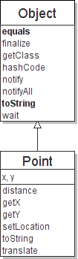
Class Object
All types of objects have a superclass named Object.
Every class implicitly extends Object
The Object class defines several methods:
public String toString() Returns a text representation of the object, often so that it can be printed.
public boolean equals(Object other) Compare the object to any other for equality. Returns true if the objects have equal state.

Slide 62
The instanceof Operator
Use the instanceof operator to test whether an object is an instance of a class:
if (variable instanceof type) {
statement(s);
}
Object myObject = new Circle();
... // Some lines of code
/** Perform casting if myObject is an instance of Circle */
if (myObject instanceof Circle) {
System.out.println("The circle diameter is " +
((Circle)myObject).getDiameter());
...
}

Slide 63
The equals Method
The equals(Object) method compares the contents of 2 objects.
object1.equals(objects); //test if 2 objects are equal
if (str1.equals(str2)) {
System.out.println("the strings are equal");
}

Slide 64
What is an interface? Why is an interface useful?
An interface is a classlike construct that contains only constants and abstract methods.
An interface is similar to an abstract class, but the intent of an interface is to specify common behavior for objects.
For example, you can specify that the objects are comparable, edible, cloneable using appropriate interfaces.

Slide 65
Define an Interface
To distinguish an interface from a class, Java uses the following syntax to define an interface:
public interface InterfaceName {
constant declarations;
abstract method signatures;
}
Example:
public interface Edible {
/** Describe how to eat */
public abstract String howToEat();
}
abstract method: A header without an implementation.
The actual body is not specified, to allow/force different classes to implement the behavior in its own way.

Slide 66
Omitting Modifiers in Interfaces
All data fields are public final static and all methods are public abstract in an interface.
For this reason, these modifiers can be omitted.
A constant defined in an interface can be accessed using syntax InterfaceName.CONSTANT_NAME (e.g., T1.K).

Slide 67
Interface is a Special Class
An interface is treated like a special class in Java. Each interface is compiled into a separate bytecode file.
Like an abstract class, you cannot create an instance from an interface using the new operator
Interface can be used as a data type for a variable, as the result of casting, etc.

Slide 68
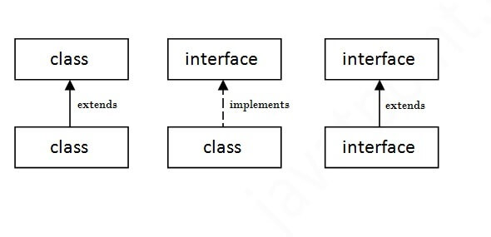
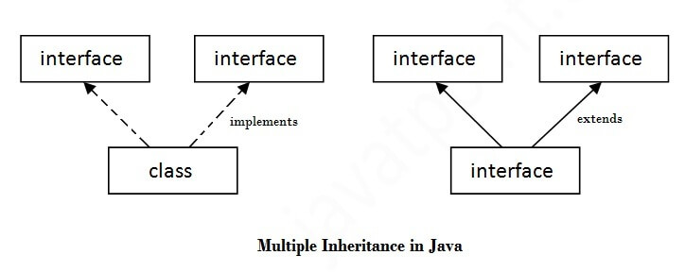
If a class implements multiple interfaces, or an interface extends multiple interfaces, it is known as multiple inheritance.

Slide 69
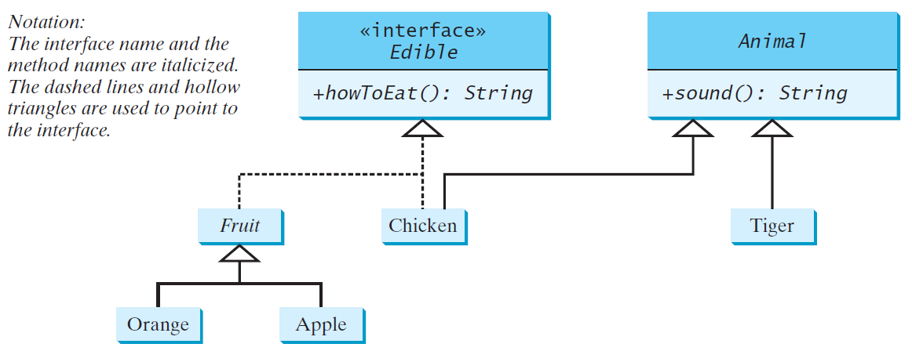
How to use interface?
Edible interface to specify whether an object is edible.
Use the implements keyword to implement interface.
The classes Chicken and Fruit implement the Edible interface.

Slide 70
public interface Edible {
/** Describe how to eat */
public abstract String howToEat();
}
public class TestEdible {
public static void main(String[] args) {
Object[] objects = {new Tiger(), new Chicken(), new Apple()};
for (int i = 0; i < objects.length; i++) {
if (objects[i] instanceof Edible)
System.out.println(((Edible)objects[i]).howToEat());
if (objects[i] instanceof Animal) {
System.out.println(((Animal)objects[i]).sound());
}
}
}
}
//put this into the interface class file
//The rest of the codes including the next 2 pages, put into another class file

Slide 71
abstract class Animal {
/** Return animal sound */
public abstract String sound();
}
class Chicken extends Animal implements Edible {
@Override
public String howToEat() {
return "Chicken: Fry it";
}
@Override
public String sound() {
return "Chicken: cock-a-doodle-doo";
}
}
class Tiger extends Animal {
@Override
public String sound() {
return "Tiger: RROOAARR";
}
}

Slide 72
abstract class Fruit implements Edible {
// Data fields, constructors, and methods omitted here
}
class Apple extends Fruit {
@Override
public String howToEat() {
return "Apple: Make apple cider";
}
}
class Orange extends Fruit {
@Override
public String howToEat() {
return "Orange: Make orange juice";
}
}

